Slide 1
Other Common Operators
ELEC1006: ENGINEERING COMPUTING

Slide 2

Operators
Assignment (=)
Arithmetic operators (+, -, *, /, %)
Compound assignment (+=,-=,*=,/=, %=, >>=,<<=, &=, ^=, |=)
Increase and decrease (++, --)
Relational and equality operators (<, >, <=, >=, ==, !=)
Logical operators (!, &&, ||)
Bitwise operators (&, |, ^, ~, <<, >>)
Conditional operator (?)
Comma operator (,)
Bitwise operator
Explicit type casting operator
Precedence of operators.
PAGE 2

Slide 3
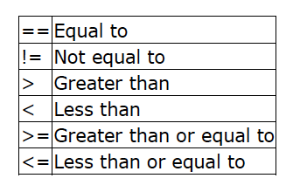
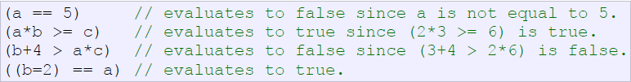
Relational and Equality Operators
Used to evaluate a comparison between two expressions
== is not the same as =
e.g. a=2, b=3, c=6;
What will this statement produce b=2==a ?????
PAGE 3

Slide 4
Logical Operators
! Is the logic NOT operation (only has ONE operand)
&& is the logic AND operation (needs TWO operand)
|| is the logic OR operation (Two operand)
eg. a=3, b=5;
!(a==b) is true (similar to a!=b)
(a>3)&&(b<7) is false
(a>3)||(b<7) is true
PAGE 4

Slide 5
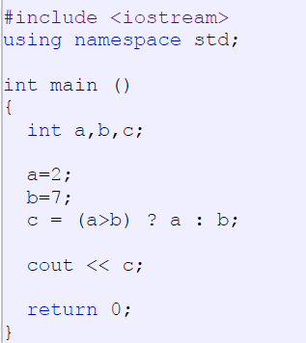
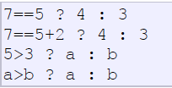
Conditional Operator
Evaluates an expression returning a value if that expression is true and a different one if the expression is false.
Its format is:
condition ? result1 : result2
True – result 1
False – result 2
PAGE 5

Slide 6
Comma Operator
Used to separate two or more expressions that are included where only one expression is expected
When the set of expressions has to be evaluated for a value, only the rightmost expression is considered:
a = (b = 2, b+3); b=2; a=b+3;
PAGE 6

Slide 7
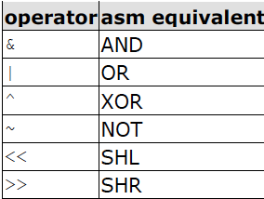
Bitwise Operator
Single bit operations.
1 bit only has binary (2) states.
0 (FALSE) or 1 (TRUE).
NOT inverts states, i.e. 1 → 0 and 0 → 1.
Refer to the Truth Table for the possible states.
SHL refers to shift left operation:
001 → 010.
SHR refers to shift right operation:
110 → 011.
Truth Table
Input 1 | Input 2 | AND | OR | XOR
0 | 0 | 0 | 1 | 0
0 | 1 | 0 | 1 | 1
1 | 0 | 0 | 1 | 1
1 | 1 | 1 | 1 | 0
PAGE 7

Slide 8
Type Casting Operator
Operations are performed between operands of the same type.
If not of the same type, C++ will convert one to be the type of the other
This can impact the results of calculations.
e.g: float a=10.0;
int b=4;
int c=a/b;
c = 2 instead of c = 2.5 due to c
being an integer instead of float.
PAGE 8

Slide 9
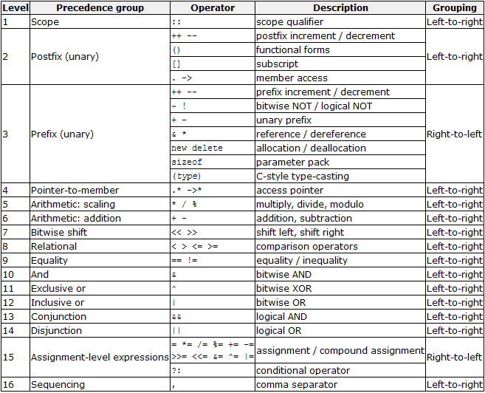
Precedence of Operators
PAGE 9

Slide 10
More info on C++
[1] cplusplus.com: Operators
https://cplusplus.com/doc/tutorial/operators/
PAGE 10

